Slide 1



SP6T Control System
MEMSDuino
Lafe Spietz
NIST
2024

Slide 2
Abstract
This circuit board
MEMSDuino

Slide 3
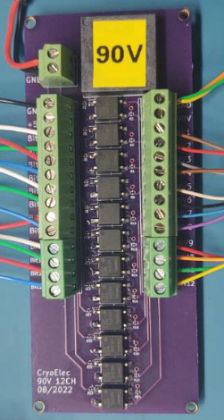
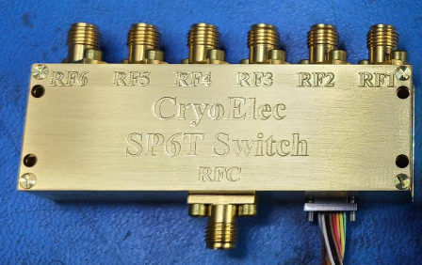
https://www.cryoelec.com/products/cryoswitchsp6t

Slide 4
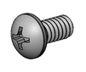
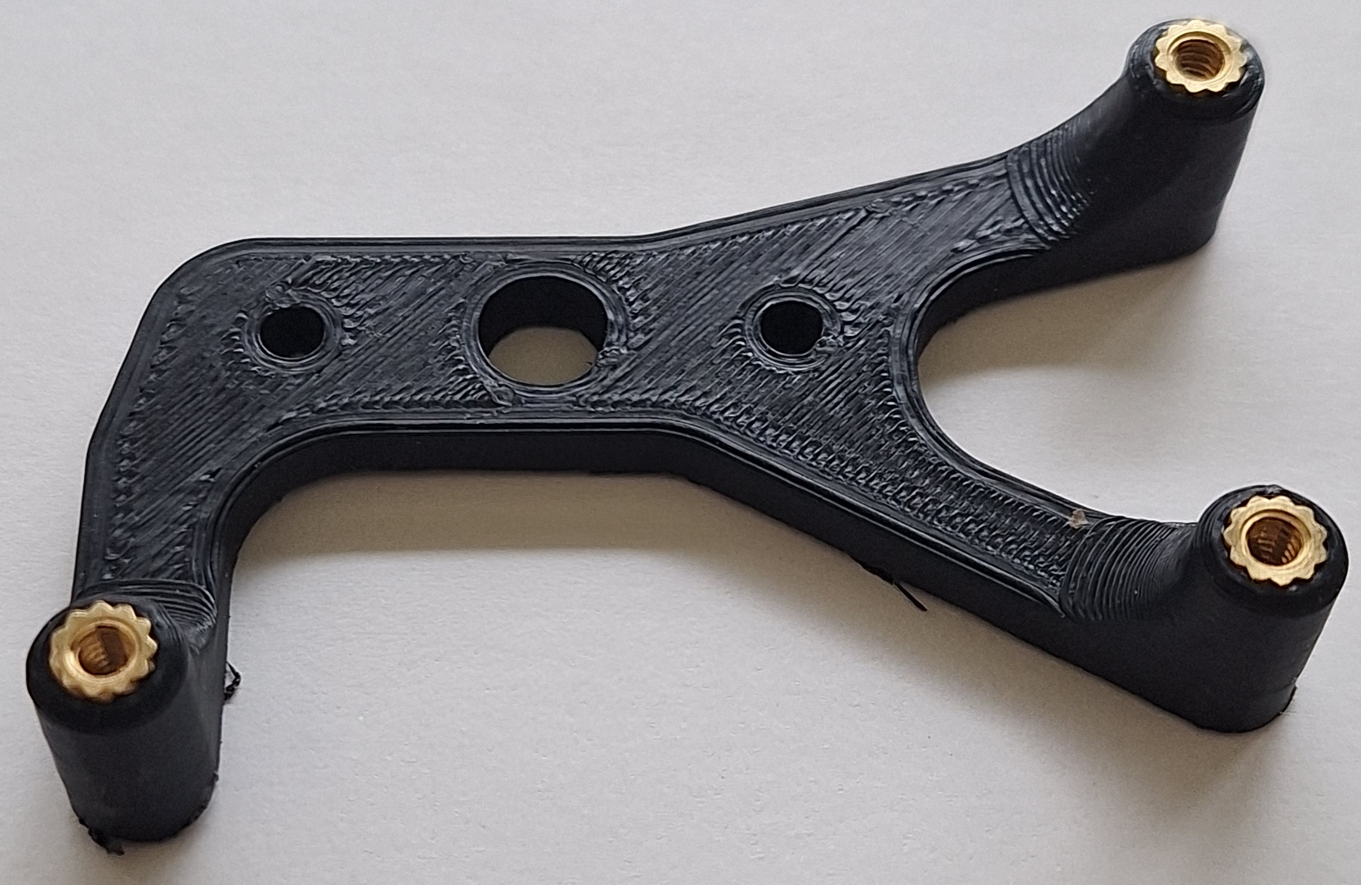
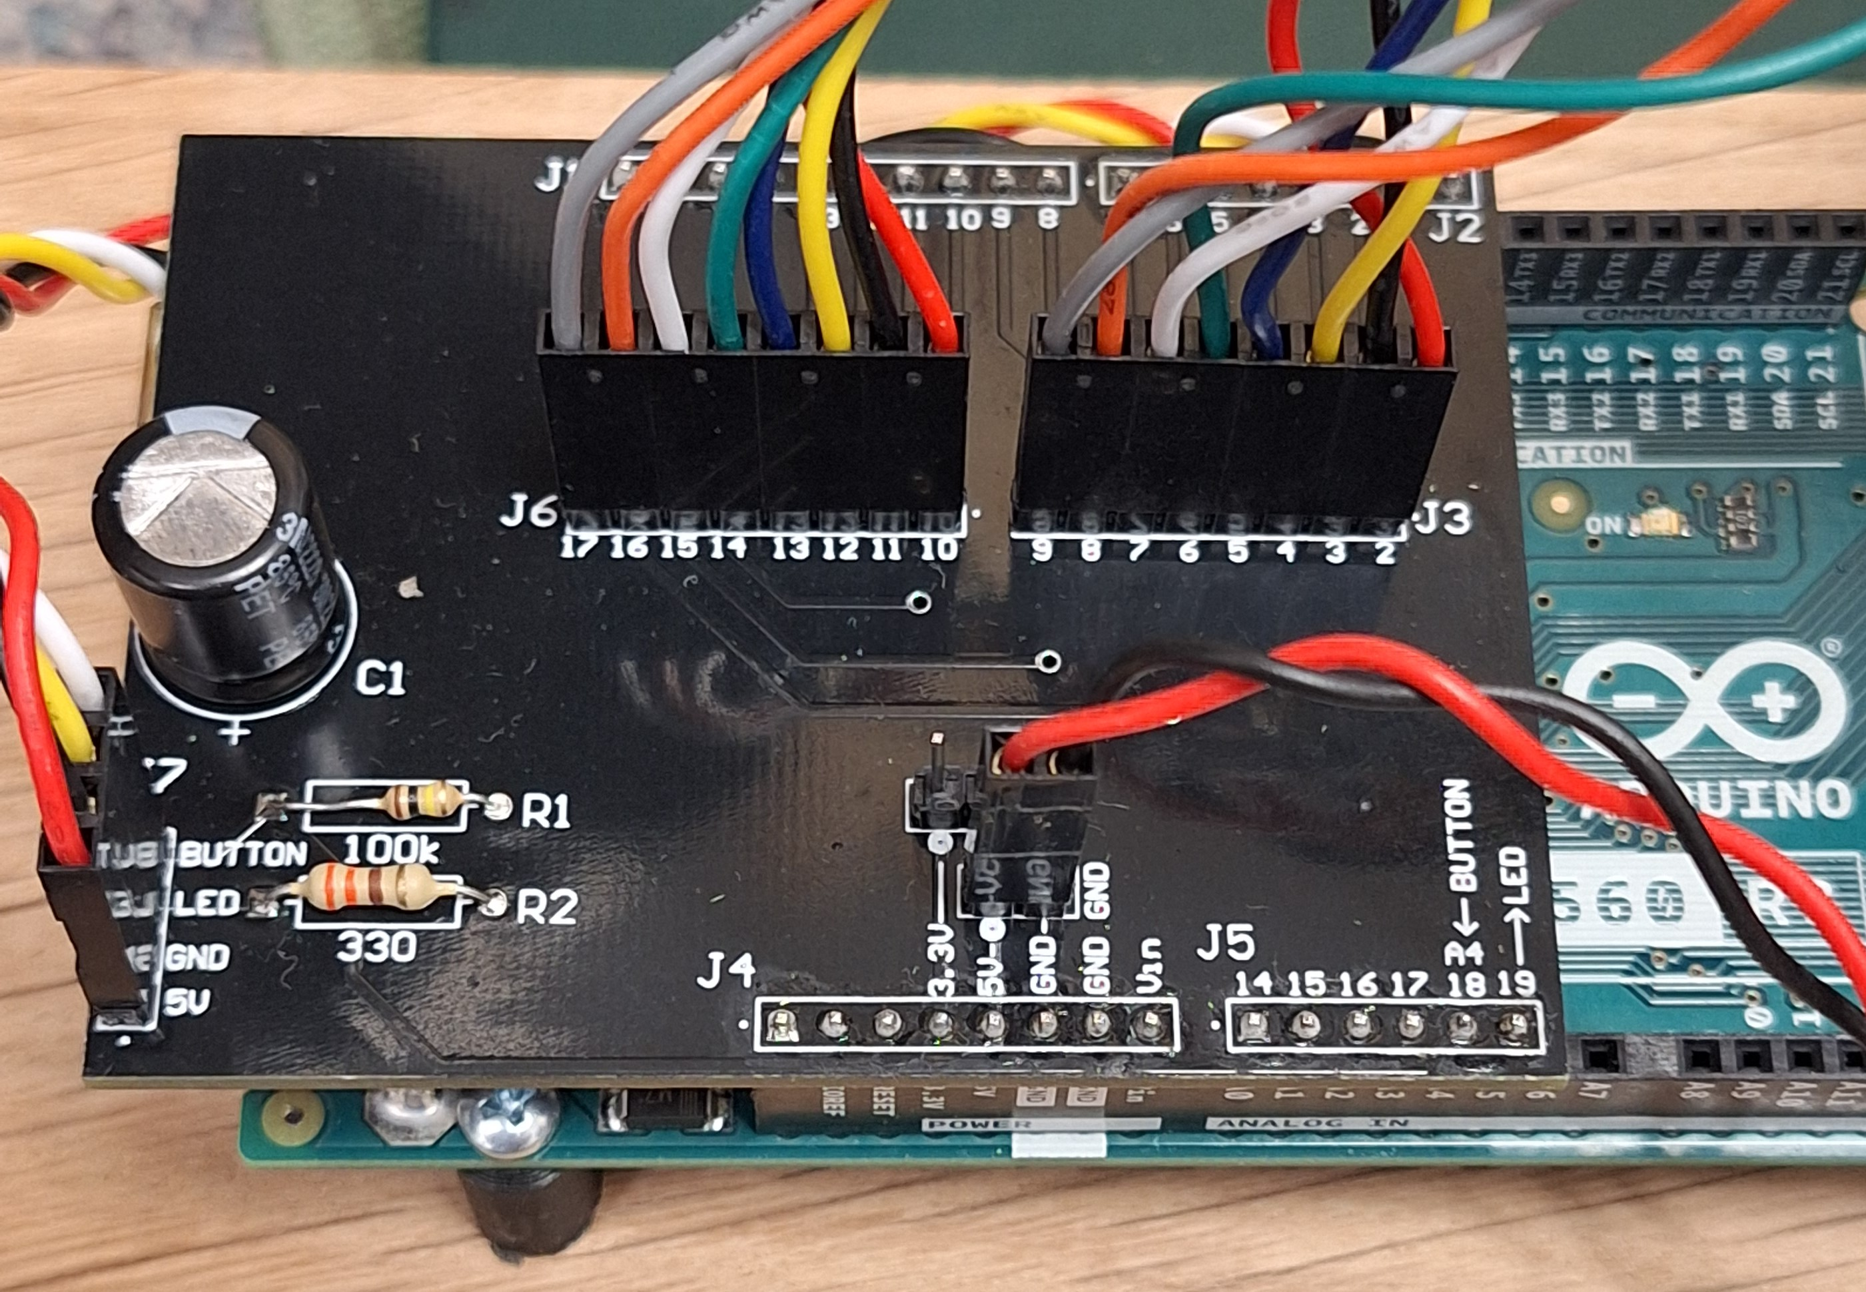
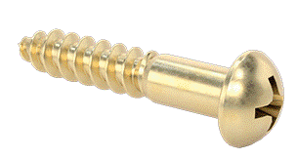

Slide 5
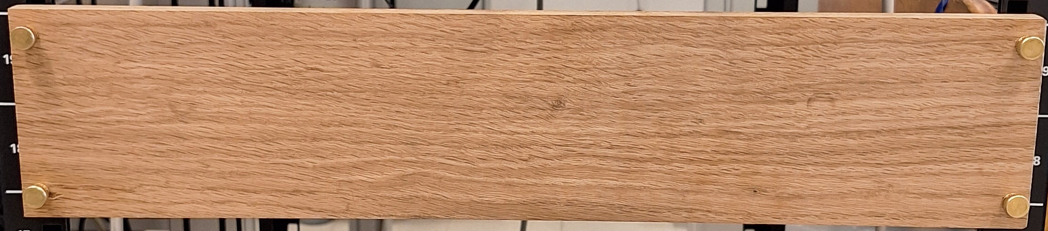
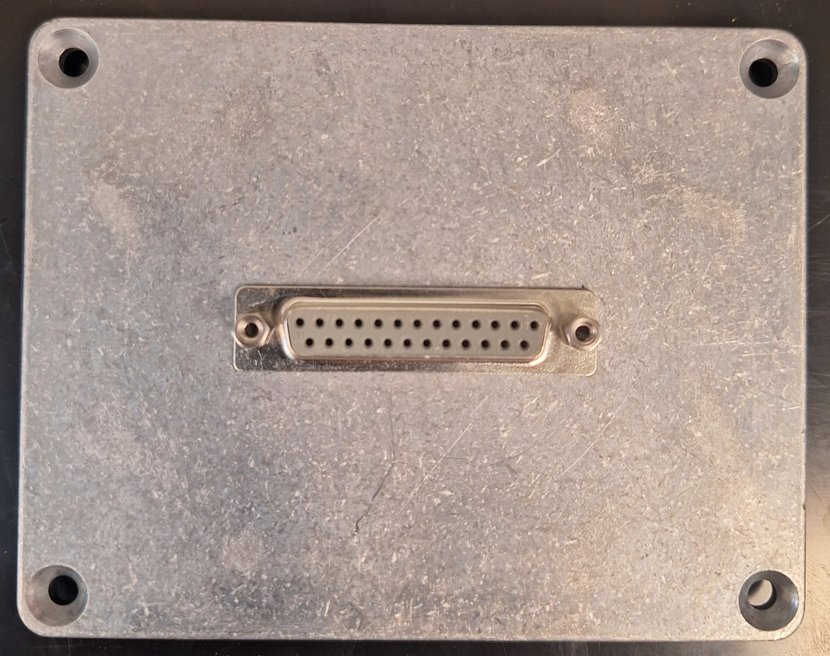
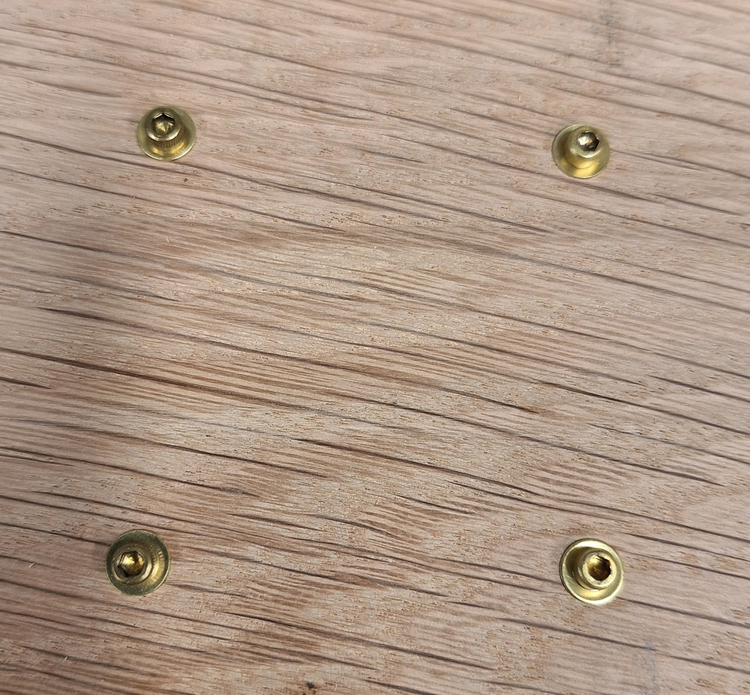

Slide 6
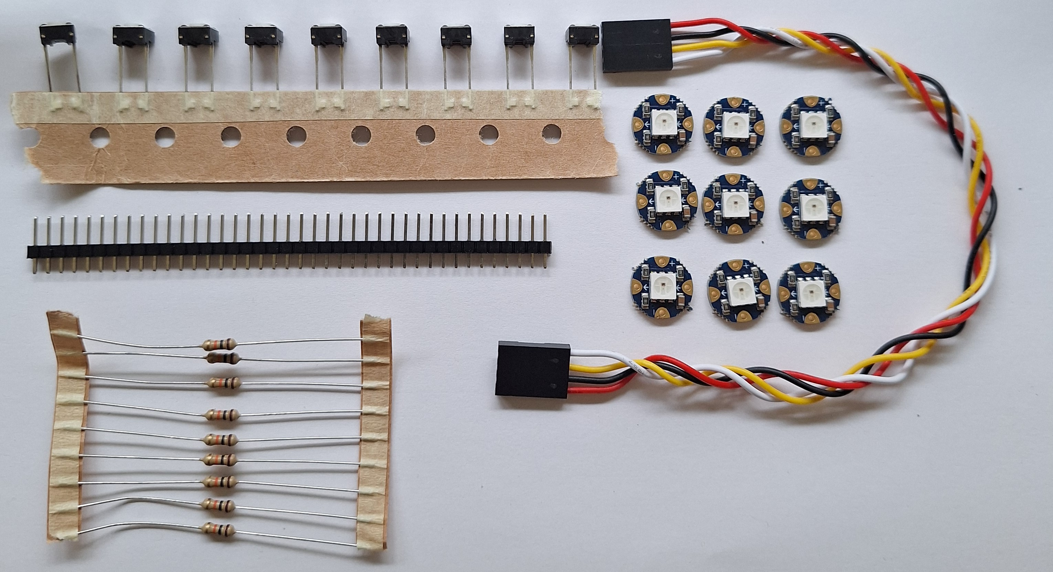
Order Components
4 Wire Header cable, 6” long x1
Button x6
https://www.amazon.com/ZYAMY-Dupont-Connector-Multicolor-Breadboard/dp/B0789F523N/
https://www.digikey.com/en/products/detail/e-switch/TL59NF160Q/390533
10 kOhm axial resistor x6
NeoPixel RGB programmable LED x6
https://www.digikey.com/en/products/detail/yageo/MFR-25FBF52-10K/13219
https://www.adafruit.com/product/1559
MEMSDuino

Slide 7
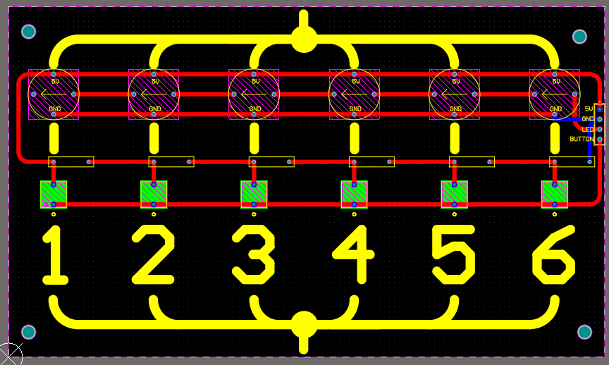
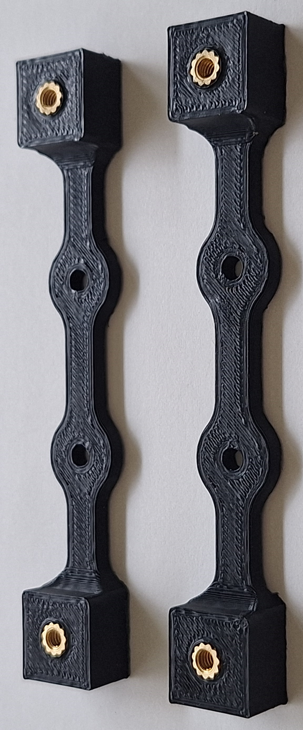

Slide 8
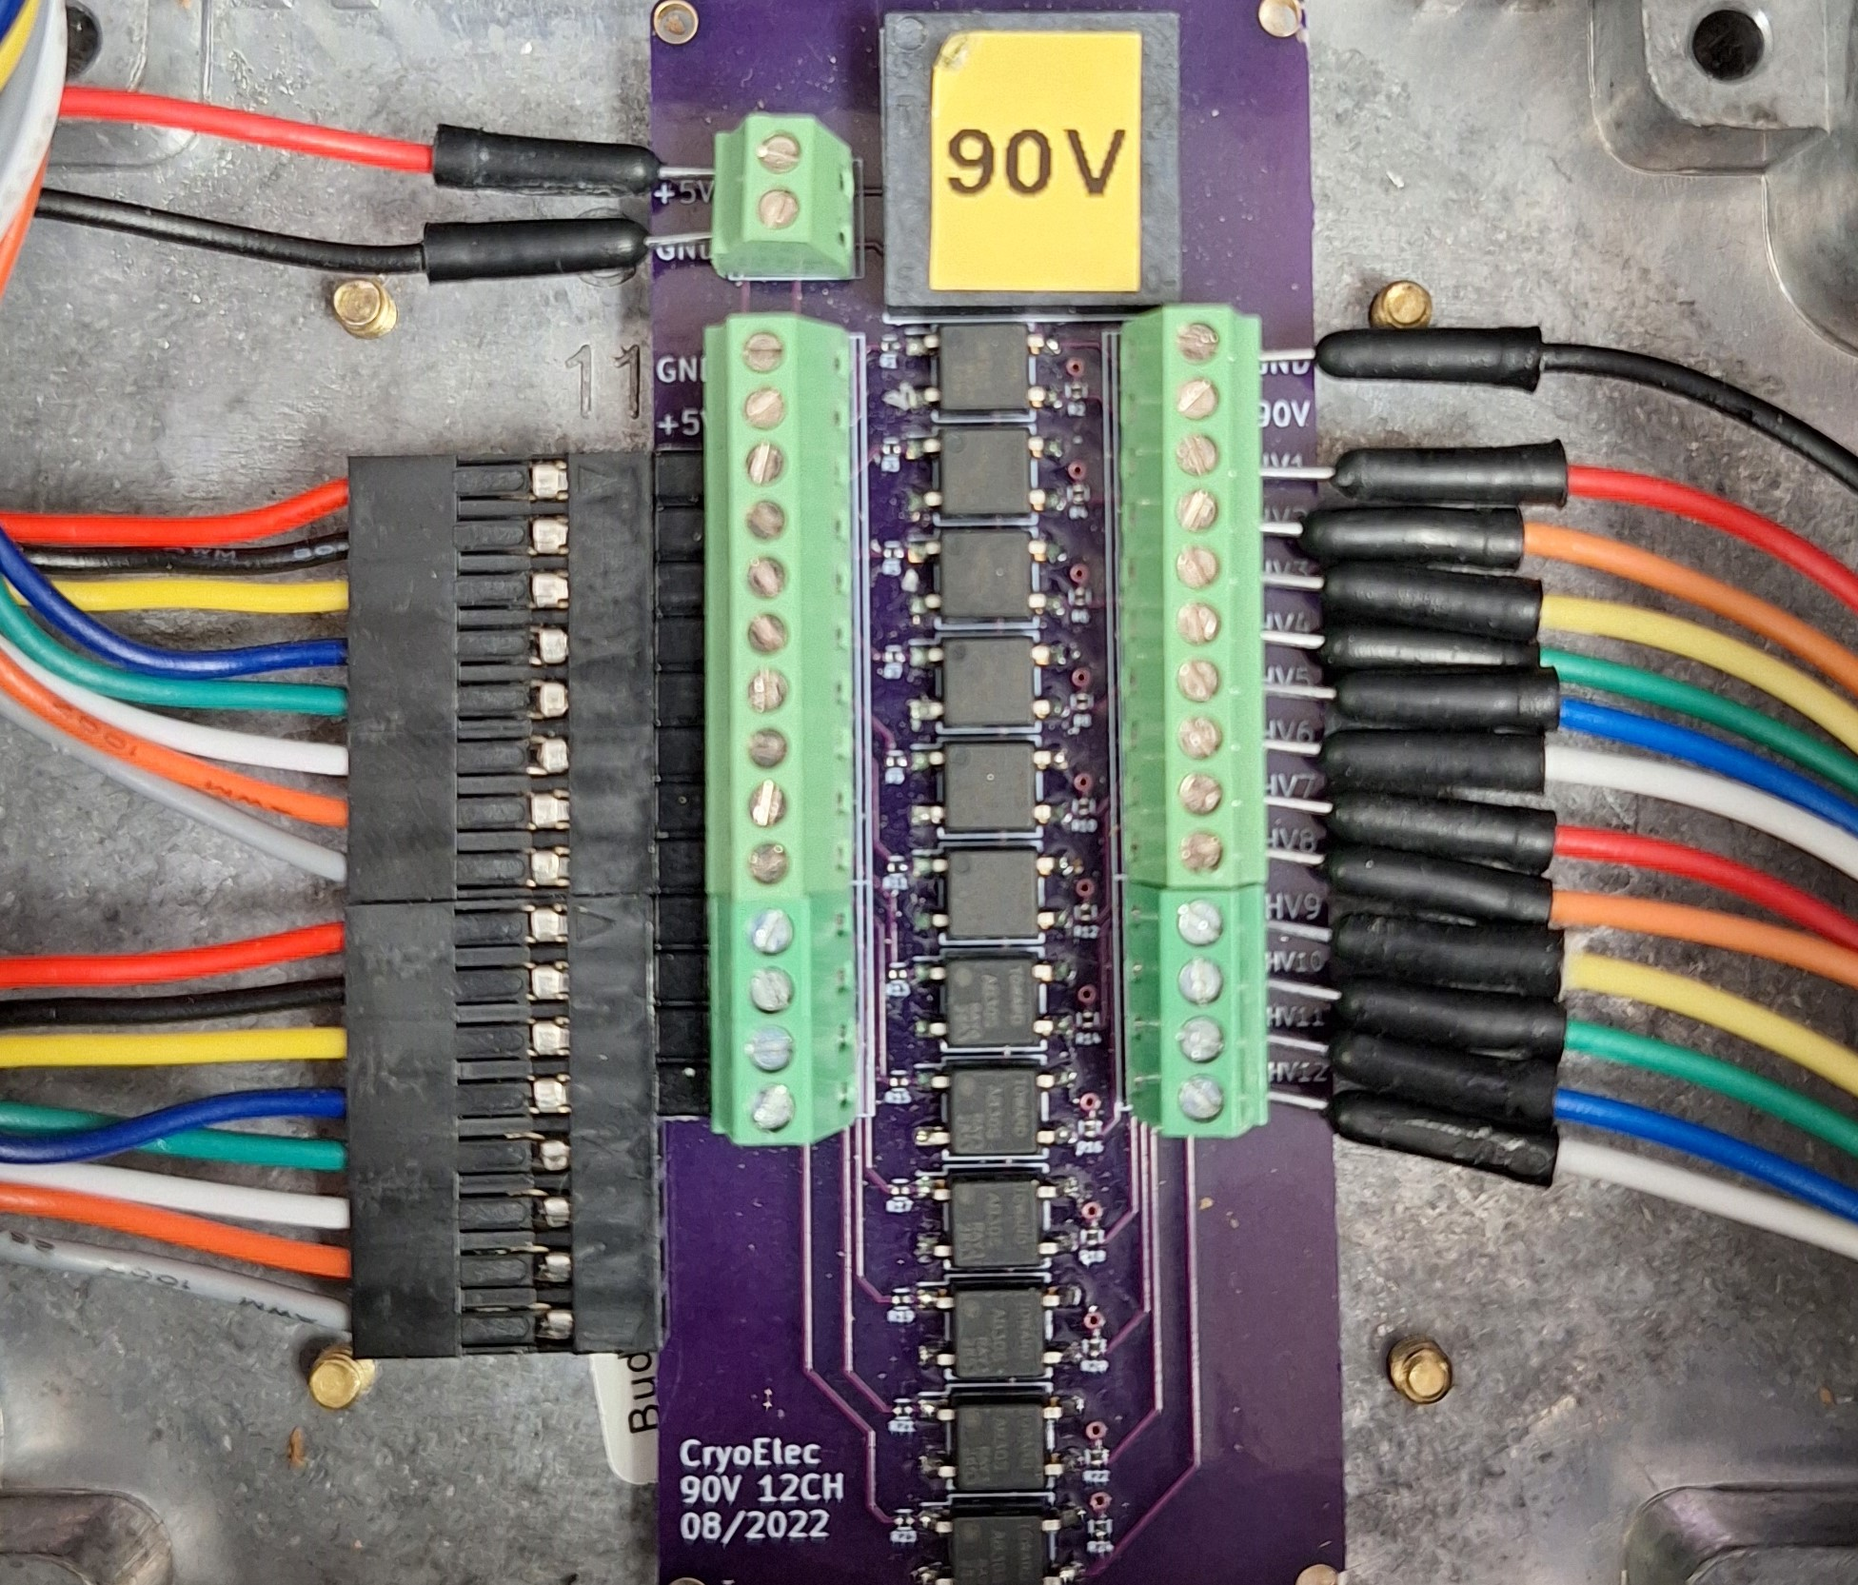
MEMSDuino

Slide 9
Conclusions:
MEMSDuino

